Slide 1
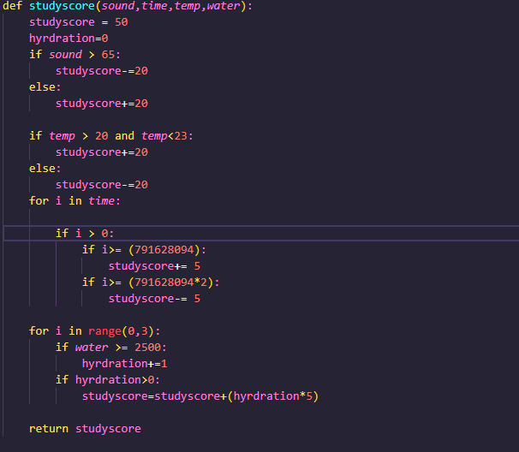
Computer Science Project
Exam Number: 113652

Slide 2
Microbit:

